Slide 1
Linked Chain Concepts

Slide 2
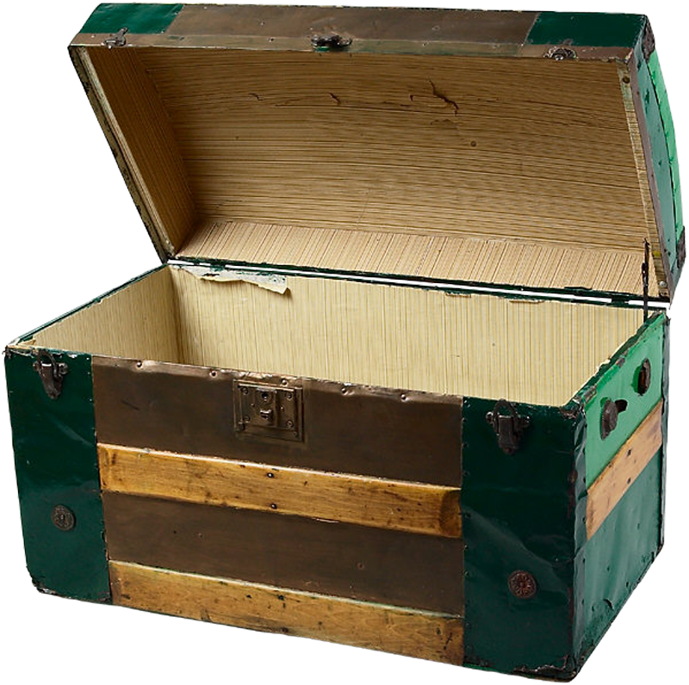

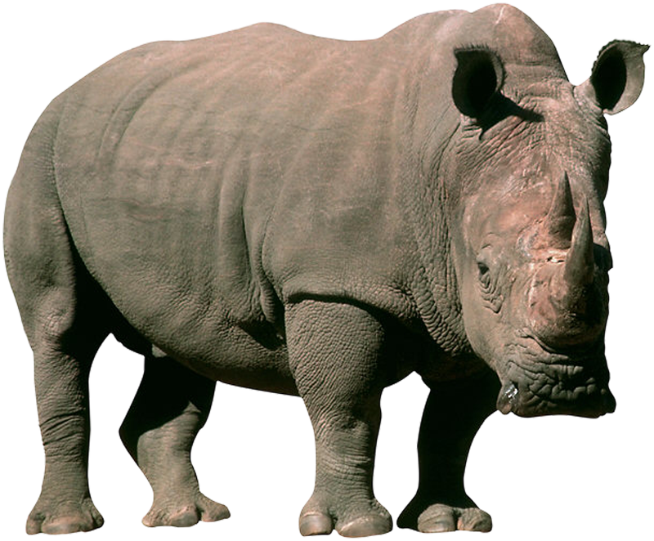

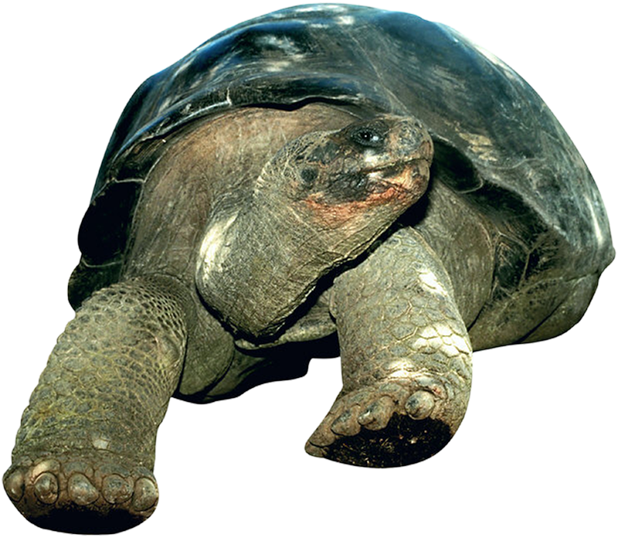






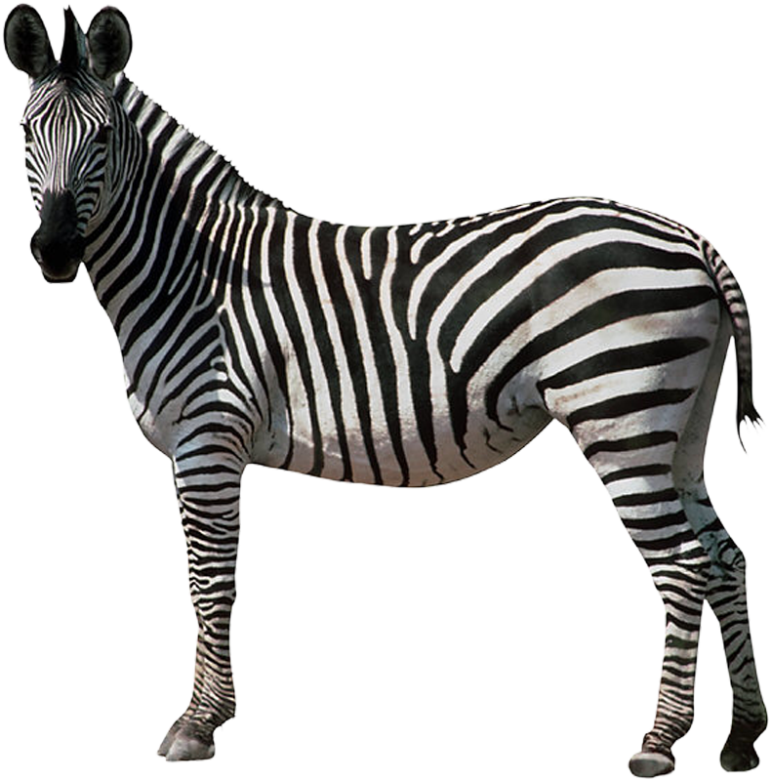

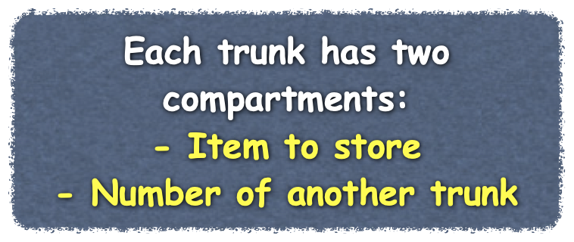
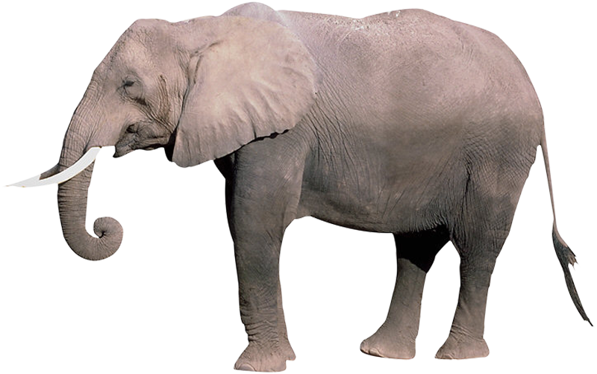
Linked Data
??
43
71
256
34
75
128
128
75
34
256
71
43
Notes:
This lecture presents the concept of linked data. Lets begin by looking at someone who needs to store some items
@@ Here we have a young business executive that is moving to a new office. He needs to pack up his prized realistic stuffed animal collection for transportation.
@@ The moving company has a set of trunks that he can use to pack is toys.
@@ Each trunk has a reference number so it can be tracked
@@ And enough space for one toy and the reference number of another trunk
@@ Because our executive is so busy trading stocks and making important decisions, he only has time to remember the reference number of one trunk.
@@ Each time he asks the moving company for a trunk, he doesn't know what number will be on it.
@@ Since he can only remember one number at a time, he places the number he knows in the new trunk along with the toy. Then he works at remembering the number of the newest trunk.
@@ As he receives each new trunk, he repeats these steps of placing the toy and the number of the last trunk into the newest trunk, and he only remembers the number of the newest trunk.
Using this method, he has formed a chain with the trunks.
@@ He knows where the first trunk located because he remembers that number.
@@ To get to the second trunk, he looks at the first trunk to find the second trunks number.
@@ He can use the same technique to find all of the other trunks. He knows he has reached the end of the chain when he gets to a trunk that does not have a reference to another trunk - the next trunk compartment is empty - or null
We can us the same idea to hold a collection of data in our bag.

Slide 3
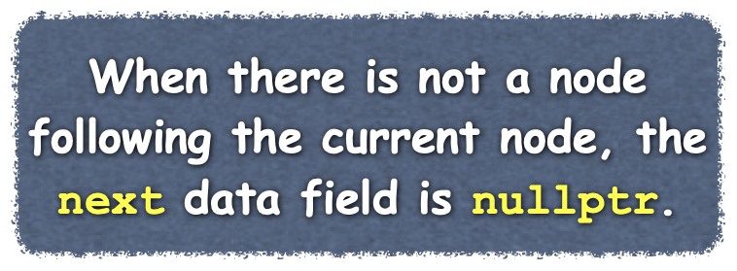

Linked Data
Node
Object used for linking together data
Two data fields
Data item in the collection
Address of the next node in the chain
Head
References the first node in the chain
Turtle
Elephant
Giraffe
/
item
next
item
next
item
next
head
Notes:
We can represent the trunk using an object called a Node. Nodes are objects that are linked together to form a data structure
@@ Each node has two data fields
@@ One references the data item stored in the collection
@@ The second data field holds to reference the next node in the chain
When there is not a node following the current node, the next data field is nullptr. We typically represent that with a slash or a dot in our diagrams.
@@ To access the nodes linked into a chain, we only need to hold a reference to the first node. This reference is often called the "head" or "first Node" of the chain.
@@ Sometimes, to reduce clutter in our diagrams, we show the item referenced by the node's data field as if it was stored in the node inside the data field itself. This does not imply the object is in the node, the node still contains only a reference to the object.
@@ (for next slide) Let's look at an algorithm for building a linked chain by adding new nodes at the front or head of the chain

Slide 4
Linked Data
Forming a Chain
Asked to store item
Create a node
Store reference to item
Store reference to new node in head
While there are more items
Create a node
Store reference to item
Copy reference in head to next field in node
Store reference to new node in head
Turtle
Elephant
Giraffe
/
item
next
item
next
item
next
/
head
Notes:
We start with a variable that holds a reference to the first node in the chain. This should be null when we begin since there are no nodes in our chain.
@@ When asked to store an item,
@@ We create a new node
@@ Store a reference to the item in the field item of the node
@@ and then store a reference to the node just created in the variable head (or firstNode - which ever we decided to call it)
The steps to store additional items in the chain are very similar.
@@ As long as we are asked to store items
@@ We create a new node for each item
@@ Store a reference to the data item
@@ Then since there is already at least one node in our chain, we copy the reference from our variable head into the next data field of our new node.
@@ Then we store a reference to this new node in the variable head.
@@ These same steps are then repeated for each additional item we want to store.

Slide 5
Class Node
Node.h
Data fields for
Data stored in the Node
Reference to next node in the chain
Constructors
With references to data and the next node
With reference only to next node
Set next to nullptr
Accessor and mutator methods
For getting a reference to the data or next node
For setting the next node and the data
/** @file Node.h */
#ifndef _NODE
#define _NODE
template<class ItemType>
class Node
{
private:
ItemType item;
Node<ItemType>* next;
public:
Node();
Node(const ItemType& anItem);
Node(const ItemType& anItem, Node<ItemType>* nextNode);
void setItem(const ItemType& anItem);
void setNext(Node<ItemType>* nextNode);
ItemType getItem() const;
Node<ItemType>* getNext() const;
}; // end Node
#include "Node.cpp"
#endif
Notes:
How would we define a Node? We can make our node generic so it is able to store what every type of data we need.
@@ We begin with the data fields. item - is an object of the generic type ItemType and next is a reference to the next node in the chain.
@@ We can create two constructors. The first takes the data to be stored in the node and the next node in the chain and uses these to initialize our data fields.
@@ The Second only has the data item to be stored and initializes the reference to the next node to null. We don't need a default constructor since without data to store in the node, we don't need to create the node.
@@ Last we can implement simple accessor and mutator methods (or getters and setters) for the two data fields.
{ Edit Out: In most collections, the data item referenced by a node does not change once after the node is initialized so we omitted the set method for the data portion of the node, but it can also be implemented similar to the setNextNode method. }}

Slide 6
Class Node
Node.h
Node.cpp
Data fields for
Data stored in the Node
Reference to next node in the chain
Constructors
With reference only to next node
Set next to nullptr
With references to data and the next node
Accessor and mutator methods
For getting a reference to the data or next node
For setting the next node and the data
/** @file Node.cpp */
#include "Node.h"
template<class ItemType>
Node<ItemType>::Node()
: next(nulptr)
{ } // end default constructor
template<class ItemType>
Node<ItemType>::Node(const ItemType& anItem)
: item(anItem), next(nullptr)
{ } // end constructor
template<class ItemType>
Node<ItemType>::Node(const ItemType& anItem,
Node<ItemType>* nextNode)
: item(anItem), next(nextNode)
{ } // end constructor
Notes:
How would we define a Node? We can make our node generic so it is able to store what every type of data we need.
@@ We begin with the data fields. item - is an object of the generic type ItemType and next is a reference to the next node in the chain.
@@ We can create two constructors. The first takes the data to be stored in the node and the next node in the chain and uses these to initialize our data fields.
@@ The Second only has the data item to be stored and initializes the reference to the next node to null. We don't need a default constructor since without data to store in the node, we don't need to create the node.
@@ Last we can implement simple accessor and mutator methods (or getters and setters) for the two data fields.
{ Edit Out: In most collections, the data item referenced by a node does not change once after the node is initialized so we omitted the set method for the data portion of the node, but it can also be implemented similar to the setNextNode method. }}

Slide 7
Class Node
Node.h
Node.cpp
Data fields for
Data stored in the Node
Reference to next node in the chain
Constructors
With reference only to next node
Set next to nullptr
With references to data and the next node
Accessor and mutator methods
For getting a reference to the data or next node
For setting the next node and the data
template<class ItemType>
ItemType Node<ItemType>::getItem() const
{
return item;
} // end getItem
template<class ItemType>
Node<ItemType>* Node<ItemType>::getNext() const
{
return next;
} // end getNext
template<class ItemType>
void Node<ItemType>::setItem(const ItemType& anItem)
{
item = anItem;
} // end setItem
template<class ItemType>
void Node<ItemType>::setNext(Node<ItemType>* nextNode)
{
next = nextNode;
} // end setNext
Notes:
How would we define a Node? We can make our node generic so it is able to store what every type of data we need.
@@ We begin with the data fields. item - is an object of the generic type ItemType and next is a reference to the next node in the chain.
@@ We can create two constructors. The first takes the data to be stored in the node and the next node in the chain and uses these to initialize our data fields.
@@ The Second only has the data item to be stored and initializes the reference to the next node to null. We don't need a default constructor since without data to store in the node, we don't need to create the node.
@@ Last we can implement simple accessor and mutator methods (or getters and setters) for the two data fields.
{ Edit Out: In most collections, the data item referenced by a node does not change once after the node is initialized so we omitted the set method for the data portion of the node, but it can also be implemented similar to the setNextNode method. }}

Slide 8
Linked Chain Concepts

Slide 9

Implementing a LinkedBag
Steps to Follow
Decide on Data Fields
Implement Constructor
Initialize the data fields
Implement Core Functions
Methods critical to collection functionality
Methods to check status of collection
Test Your Implementation
Implement Additional Methods
Test Your Implementation
/** @file Node.h */
#ifndef _NODE
#define _NODE
template<class ItemType>
class Node
{
private:
ItemType item;
Node<ItemType>* next;
public:
Node();
Node(const ItemType& anItem);
Node(const ItemType& anItem, Node<ItemType>* nextNode);
void setItem(const ItemType& anItem);
void setNext(Node<ItemType>* nextNode);
ItemType getItem() const;
Node<ItemType>* getNext() const;
}; // end Node
#include "Node.cpp"
#endif
template<class ItemType>
class BagInterface
{
public:
/** Gets the current number of entries in this bag.
@return the integer number of entries currently in the bag */
virtual int getCurrentSize() const = 0;
/** Sees whether this bag is empty.
@return true if the bag is empty, or false if not */
virtual bool isEmpty() const = 0;
/** Adds a new entry to this bag.
@post if successful, newEntry in stored in bag and
count of items in the bag is increased by 1
@param newEntry the object to be added as a new entry
@return true if addition is successful, or false if not */
virtual bool add(const ItemType& newEntry) = 0;
/** Removes one occurrence of a given entry from this bag,
if possible.
@post if successful, anEntry has been removed from the bag
and the count of items in the bag has decreased by 1
@param anEntry the entry to be removed
@return true if removal was successful, or false if not */
virtual bool remove(const ItemType& target) = 0;
/** Removes all entries from this bag.
@post bag contains no items and the count of items is 0 */
virtual void clear() = 0;
/** Counts the number of times a given entry appears in bag.
@param anEntry the entry to be counted
@return the number of times anEntry appears in the bag */
virtual int getFrequencyOf(const ItemType& target) const = 0;
/** Tests whether this bag contains a given entry.
@param anEntry the entry to locate
@return true if bag contains anEntry, or false otherwise */
virtual bool contains(const ItemType& anEntry) const = 0;
/** Fector with of all entries thatare in this bag.
@param bagContents a vector
@post bagContents contains all the entries in the bag */
virtual std::vector<ItemType> toVector() const = 0;
}; // end BagInterface
#endif
Notes:
Now lets look at using a linked chain to store the data in an implementation of the ADT bag. We can follow the same steps that we used for implementing the class ArrayBag by
@@ Deciding on data fields,
@@ Implement our constructor to initialize the data fields
@@ Implementing core functions, such as add and toArray
@@ At this point the implementation of the LinkedBag can be tested
@@ and then we can implement additional methods.
@@ This LinkedBag will use a Node of generic type to store the items in our bag. Here is the implementation we developed in our previous lecture. We are not going to define the node class as an inner class, we will keep it as it's own class.

Slide 10
Decide on Data Fields
LinkedBag.h
Items are stored in a linked chain
Reference to the first node in the chain
Number of entires in the chain
template<class ItemType>
class LinkedBag : public BagInterface<ItemType>
{
private:
Node<ItemType>* headPtr;
int itemCount;
Node<ItemType>* getPointerTo(const ItemType& anEntry) const;
public:
LinkedBag();
LinkedBag(const LinkedBag<ItemType>& aBag);
~LinkedBag();
int getCurrentSize() const;
bool isEmpty() const;
bool add(const ItemType& newEntry);
bool remove(const ItemType& anEntry);
void clear();
bool contains(const ItemType& anEntry) const;
int getFrequencyOf(const ItemType& anEntry) const;
void toVector(std::vector<ItemType>& bagContents) const;
}; // end LinkedBag
Notes:
The data in our LinkedBag implementation is stored in a linked chain. To manage our linked chain, we only need to store a reference to the head or first node in the chain.
@@ So we declare a private data field of a generic Node type called headPtr.
@@ We should also track the number Of Entries stored in the bag. In our ArrayBag implementation we were required to store the the number of items in the bag in a data field called itemCount so we could determine which array elements had data from our bag and which array elements were beyond the entries in the bag. We had to do this because we needed to declare an array large enough to hold all of the items we might possibly need to store in the bag. The data field ItemCount let us know where the last entry was stored.
In a linked chain, we only create nodes when we need to store an item in the bag. Therefore, every node in the chain is used to store data.
We could implement our another way by not storing the number Of Entries, instead, every time we wanted to know how many items were in our bag, we could iterate through the chain and count the nodes.
This would work, but as the bag grows to hold more and more items, this would take longer and longer. It is more efficient to store the number Of Entries currently in the bag and update the number every time we do an add or remove. So we’ll use the data field itemCOunt to hold the number of entries in the bag and update it each time we add or remove an item.

Slide 11
Implementing Constructors
LinkedBag.cpp
Must happen before other class methods can be called
Ensure all data fields are initialized
No items in bag
template<class ItemType>
LinkedBag<ItemType>::LinkedBag()
: headPtr(nullptr), itemCount(0)
{
} // end default constructor
Notes:
Our LinkedBag only needs a single constructor. When we implemented the ArrayBag, we gave the client the option of creating an empty bag with a default capacity or an empty bag with a capacity specified by the client. Since the LinkedBag has a capacity limited only by the memory on the computer, we can have a single constructor that creates the empty bag.
The constructor must initialize firstNode to null since there are no nodes in the chain when the bag is empty.
And it must initialize number of entries to zero since there are no items in the bag at this point.

Slide 12
Implementing Core Methods
LinkedBag.cpp
Place items into bag
Create a node and store reference to item
Copy reference in head (headPtr) to next field in node
Store reference to new node in head
Increment number of entries in bag
template<class ItemType>
bool LinkedBag<ItemType>::add(const ItemType& newEntry)
{
// add to beginning of chain: new node references rest of chain;
// (headPtr is null if chain is empty)
Node<ItemType>* nextNodePtr = new Node<ItemType>(newEntry, headPtr);
headPtr = nextNodePtr; // new node is first node
itemCount++;
return true;
} // end add
Turtle
Elephant
Giraffe
nextNodePtr
nextNodePtr
nextNodePtr
item
next
item
next
item
next
/
/
itemCount
1
3
2
headPtr
0
Notes:
Now that our bag is initialized and empty, we can begin to add items to it.
Let's step through how our add algorithm works
When our LinkedBag is first created, it is empty - headPtr is nullptr and itemCount is zero. Our add method is passed an item to add to the bag - in this case, a Giraffe.
@@ We create a node and store the item in the node and copy the reference in headPtr to the Next field in this node.
For the first node created in the chain, this seems redundant since the headPtr has the value nullptr and the next data field of the new node has the value nullptr, but this step becomes more important once the chain has additional nodes.
@@ The reference to the new Node is copied to headPtr so that headPtr now points to the newly created node. Notice that here, we use an assignment statement to set what headPtr references. This is because we are assigning the member variable headPtr itself to point to the node. Earlier, we wanted to assign a data field of the object referenced by newNodePTR to reference or point to a node, so we used the setNextNode method.
@@ Once we have set the references correctly, we can increment the itemCount for the bag.
@@ When the method ends, the local variable newNodePtr goes away and we are left with only our chain representing the bag.
@@ We can repeat these steps for the next item that is added to the bag.
@@ (We create a new node of the item) @@ (passing headPtr as the next node to reference in the chain)
@@ copy newNodePtr to headPtr
@@ increment itemCount, and then return true to indicate the add was successful
@@ (Turtle) and we repeat these steps with each call to add.

Slide 13





Implementing Core Methods
template<class ItemType>
std::vector<ItemType> LinkedBag<ItemType>::toVector() const
{
std::vector<ItemType> bagContents;
Node<ItemType>* curPtr = headPtr;
int counter = 1
while ((curPtr != nullptr) && (counter <= itemCount))
{
bagContents.push_back(curPtr->getItem());
curPtr = curPtr->getNext();
counter++;
} // end while
} // end toVector
Report on items in object
Allows us to determine if the items were added properly.
counter
bagContents
1
2
3
4
5
6
7
0
1
2
3
4
5
Turtle
Alligator
Zebra
Lion
Elephant
Giraffe
itemCount
Turtle
Alligator
Zebra
Lion
Elephant
Giraffe
6
/
headPtr
item
next
item
next
item
next
item
next
item
next
item
next
nullptr
curPtr
curPtr
Notes:
Now that we can add items to our bag, we need a method to tell us if they were added correctly. The toVector method can help with this.
It begins similar to the toVector method that we implemented in our ArrrayBag class -- we create an empty vector of the generic data type stored in the bag, called bagContens, of the generic data type stored in the bag. Next, we will take the items in each node of the linked chain and copy them into the vector.
let's look at how we can accomplish this.
@@ First we have the chain that represents the bag. The data field headPtr references the first node in the chain and the data field itemCount holds the number of nodes in the chain.
and We have the the vector bagcontents that was just created and has no elements.
As we iterate through the chain and copy items from the chain to the vector, we need to track our position in in the bag.
@@ The variable currentPtr is going to reference the node in the chain that we are currently examining. When we begin, we want this to point to the first node in the chain, so we initialize it to headPtr. After saving the item in the node, we will set this to the next item in the chain. When we get to the end of the chain, currentPtr should be set to nullptr and we can test for this to end the loop that traverses the chain.
Counter is the index of the item in the chain. Though testing currentPtr for nullptr should be all we need to determine if we are at the end of the chain, it is safer to also count the nodes as we process them in case the chain was mal-formed and the last node does not have its next field set to nullptr.
@@ We can now copy the item from the current node into the vector using the vector’s push_back method to create an element for the item.
@@ Then we move currentPtr to point to the next node in the chain and
@@ Increment counter to indicate we are at the next item.
@@ We can repeat this process for each item in the bag.
@@ (Zebra) @@ (Lion) @@ (Elephant)
@@ When we copy the last item in the chain, currentPtr is set to NULLPTR
@@ since the next data field of the last node is nullptr
@@ also, we know that we have processed all of the nodes since counter matches itemCOunt.
@@ We can use these two facts as a test for when we should terminate the while loop that processes the items in the bag.
@@ This is the statement to get the data from the currentPtr and place in the array element with index as the subscript
This statement is a common way to increment a variable used to iterate through a chain.
@@ Similar to how + + is used to increment an index into an array as we iterate through the array.

Slide 14
Core LinkedBag Methods

Slide 15
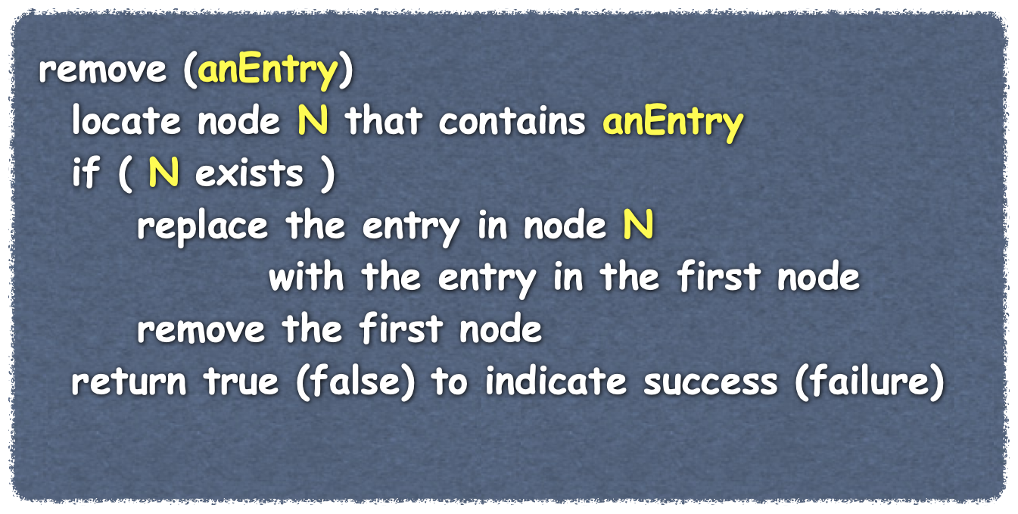



Removing a Specific Item
Turtle
Alligator
Zebra
Lion
Elephant
Giraffe
/
headPtr
item
next
item
next
item
next
item
next
item
next
item
next
itemCount
6
Notes:
Now Let's see how we can remove a specific item from the bag.
@@ here’s the pseudocode for our method to remove a specific item from the bag.
As we step through this algorithm, it is important to keep in mind that nodes only exist to store items in our bag. Which node contains an item is not important.
@@ we first find the node that contains the item, if the item is not in the bag, this should fail and we will not be able to remove the item.
@@ if the item is in the bag, there will be a node N that holds it.
@@ We copy the entry stored in the first node into node N. We do this since we already know how to remove the first node from the chain. Placing the entry in the firstNode into N will keep that item in our bag once the first node in the chain is deleted. The value that was in node N previously is not important is it to be removed anyway
@@ Since the item in that was originally in the first node is safe, we can remove the first node from the chain
@@ and return either true or false to indicate success or failure respectively.
There are three actions we perform in our algorithm to remove a specific item from the bag.
@@ First we locate the node that contains the item. This is similar to the task we must perform when we check to see if our bag hold an item in the contains method. Our contains method returns a boolean, here we must return a reference to the node so we can access that node again later.
Since the two tasks are similar and only differ in what they return, we are going to create a private method called getReferenceTo that can be used by both the contains method and our remove algorithm.
@@ We have to replace the value stored in a node. Earlier, when we developed the Node class, we had accessor and mutator methods for both data fields, we can use the setData method on the node N for this task.
@@ to remove the first node, we can use the remove method we just implemented.
@@ Let's first implement the private method getPointerTo

Slide 16
Removing a Specific Item
template<class ItemType>
Node<ItemType>* LinkedBag<ItemType>::getPointerTo( const ItemType& anEntry) const
{
bool found = false;
Node<ItemType>* curPtr = headPtr;
while (!found && (curPtr != nullptr))
{
if (anEntry == curPtr->getItem())
found = true;
else
curPtr = curPtr->getNext();
} // end while
return curPtr;
} // end getPointerTo
The method getPointerTo
returns a reference to the node containing anEntry or nullptr if anEntry is not in the bag.
while the entry has not been found and there are more nodes in the chain
compare the entry in the current node to the target entry
Lion
true
false
anEntry
found
Turtle
Alligator
Zebra
Lion
Elephant
Giraffe
/
headPtr
item
next
item
next
item
next
item
next
item
next
item
next
6
itemCount
curPtr
Notes:
Earlier, when we implemented the toVector method, we needed to create a variable that referenced the current node as we iterated through the linked chain. We again will be iterating through the linked chain as we search for the node that contains the target entry so we declare the local variable currentPtr and initialize it with a reference to the first node in the linked chain.
@@ We then iterate through the linked chain until either we find the item, thus setting Found to true or we reach the end of the chain which results in currentPtr being set to nullptr. If the bag was empty, the member variable headPtr would have been nullptr, so currentPtr would have been initialized to null and the loop would have been skipped.
@@ At each node, we compare the target entry to the data item stored in the node.
@@ If they are not equal, we increment currentPtr to reference the next node in the chain and repeat the comparison at that node.
@@ We continue incrementing currentNode and comparing until either we find the item and set Found to true or reach the end of the linked chain.
@@ If the item was found, currentPtr node references the node that holds the target entry. If the bag was empty or the item was not found in the bag, currentPtr will be nullptr.

Slide 17
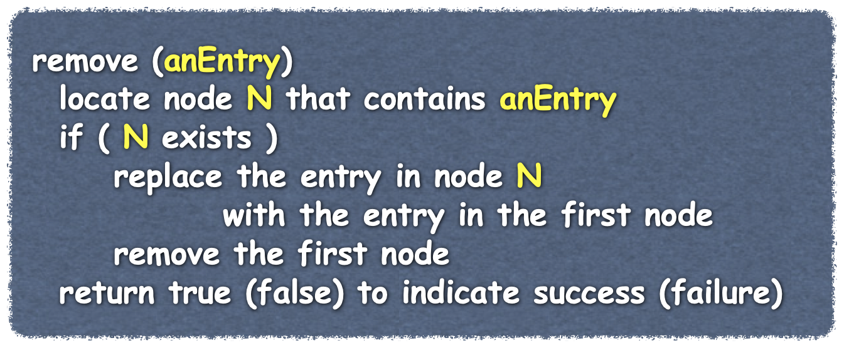
Removing an Item
template<class ItemType>
bool LinkedBag<ItemType>::remove(const ItemType& anEntry)
{
Node<ItemType>* loc = getPointerTo(anEntry);
bool canRemoveItem = !isEmpty() && (loc != nullptr);
if (canRemoveItem)
{
// copy data from first node to located node
loc->setItem(headPtr->getItem());
// delete first node
Node<ItemType>* nodeToDeletePtr = headPtr;
headPtr = headPtr->getNext();
// return node to the system
delete nodeToDeletePtr;
nodeToDeletePtr = nullptr;
itemCount--;
} // end if
return canRemoveItem;
} // end remove
Lion
true
false
anEntry
canRemove
Turtle
/
Turtle
Alligator
Zebra
Lion
Elephant
Giraffe
nodeToDeletePtr
/
headPtr
item
next
item
next
item
next
item
next
item
next
item
next
itemCount
5
6
loc
Notes:
Now we have the tools we need to remove a specific item from the bag.
When our method is called, we have the target entry that we are asked to remove from the bag.
@@ The first step in our algorithm is to locate the node N that contains the entry we want to remove. After our call to the private method getPointerTo, our local variable loc will contain a reference to the first node in the linked chain that contains the entry or nullptr, if the bag is empty or the entry is not in the bag.
@@ We will use the boolean canRemoveItem to return to the client our success or failure in removing the requested entry.
So If the entry is in the bag,
@@ We replace the item in the node N with the item stored in the first node in the chain, which is referenced by headPtr. This is an important step. Since we are going to remove the first node shortly, we must ensure the data item in the node is preserved.
@@ The data in node N is going to be removed from the bag, so that node is a good place to store the first node's data. As mentioned earlier, when working with linked data, it is important to understand that nodes exist only to hold data. Which node an item is stored in is not important as long as it is in a node in the linked chain.
@@ Now that the data in the first node has been saved in another node in the linked chain, we can safely remove the first node from the chain.
@@ We save a reference to the first node so we can delete it shortly.
@@ We then increment headPtr to point to the second node in the chain, which is now the first node in the chain.
@@ at this point, we can safely delete the first node and return it’s memory to the system. As a safety precaution, we set nodeToDeletePTr to nullPtr
@@ The remove method also decrements itemCOunt for us so we do not need to explicitly do that in this method.
@@ finally, we return canRemoveItem to indicate whether or not the remove was successful.

Slide 18
The Method contains
Use the private helper method getPointerTo
if the helper returns nullptr
the item is not in the bag
if the helper returns a reference to a node
the item is in the bag
template<class ItemType>
bool LinkedBag<ItemType>::contains( const ItemType& anEntry) const
{
return (getPointerTo(anEntry) != nullptr);
} // end contains
Notes:
The BagInterface method contains is simple to implement in our LinkedBag class since we can use the result of a call to our the private helper method getPointerTo that we created earlier.
If the helper method returns nullptr, that means that the item we searched for WAS NOT in the bag and so we should return FALSE
IF the helper method returns a reference to a node, in other words, if getPointerTo returns a value that IS NOt NULLPTR, it means that the target item was found in the bag, so our method should return true.

Slide 19
Removing a Specific Item
Turtle
Alligator
Zebra
Lion
Elephant
Giraffe
/
headPtr
item
next
item
next
item
next
item
next
item
next
item
next
itemCount
6
Notes:
Now Let's see how we can remove a specific item from the bag.
@@ here’s the pseudocode for our method to remove a specific item from the bag.
As we step through this algorithm, it is important to keep in mind that nodes only exist to store items in our bag. Which node contains an item is not important.
@@ we first find the node that contains the item, if the item is not in the bag, this should fail and we will not be able to remove the item.
@@ if the item is in the bag, there will be a node N that holds it.
@@ We copy the entry stored in the first node into node N. We do this since we already know how to remove the first node from the chain. Placing the entry in the firstNode into N will keep that item in our bag once the first node in the chain is deleted. The value that was in node N previously is not important is it to be removed anyway
@@ Since the item in that was originally in the first node is safe, we can remove the first node from the chain
@@ and return either true or false to indicate success or failure respectively.
There are three actions we perform in our algorithm to remove a specific item from the bag.
@@ First we locate the node that contains the item. This is similar to the task we must perform when we check to see if our bag hold an item in the contains method. Our contains method returns a boolean, here we must return a reference to the node so we can access that node again later.
Since the two tasks are similar and only differ in what they return, we are going to create a private method called getReferenceTo that can be used by both the contains method and our remove algorithm.
@@ We have to replace the value stored in a node. Earlier, when we developed the Node class, we had accessor and mutator methods for both data fields, we can use the setData method on the node N for this task.
@@ to remove the first node, we can use the remove method we just implemented.
@@ Let's first implement the private method getPointerTo

Slide 20
Removing a Specific Item
template<class ItemType>
Node<ItemType>* LinkedBag<ItemType>::getPointerTo( const ItemType& anEntry) const
{
bool found = false;
Node<ItemType>* curPtr = headPtr;
while (!found && (curPtr != nullptr))
{
if (anEntry == curPtr->getItem())
found = true;
else
curPtr = curPtr->getNext();
} // end while
return curPtr;
} // end getPointerTo
The method getPointerTo
returns a reference to the node containing anEntry or nullptr if anEntry is not in the bag.
while the entry has not been found and there are more nodes in the chain
compare the entry in the current node to the target entry
Lion
true
false
anEntry
found
Turtle
Alligator
Zebra
Lion
Elephant
Giraffe
/
headPtr
item
next
item
next
item
next
item
next
item
next
item
next
6
itemCount
curPtr
Notes:
Earlier, when we implemented the toVector method, we needed to create a variable that referenced the current node as we iterated through the linked chain. We again will be iterating through the linked chain as we search for the node that contains the target entry so we declare the local variable currentPtr and initialize it with a reference to the first node in the linked chain.
@@ We then iterate through the linked chain until either we find the item, thus setting Found to true or we reach the end of the chain which results in currentPtr being set to nullptr. If the bag was empty, the member variable headPtr would have been nullptr, so currentPtr would have been initialized to null and the loop would have been skipped.
@@ At each node, we compare the target entry to the data item stored in the node.
@@ If they are not equal, we increment currentPtr to reference the next node in the chain and repeat the comparison at that node.
@@ We continue incrementing currentNode and comparing until either we find the item and set Found to true or reach the end of the linked chain.
@@ If the item was found, currentPtr node references the node that holds the target entry. If the bag was empty or the item was not found in the bag, currentPtr will be nullptr.

Slide 21
Removing an Item
template<class ItemType>
bool LinkedBag<ItemType>::remove(const ItemType& anEntry)
{
Node<ItemType>* loc = getPointerTo(anEntry);
bool canRemoveItem = !isEmpty() && (loc != nullptr);
if (canRemoveItem)
{
// copy data from first node to located node
loc->setItem(headPtr->getItem());
// delete first node
Node<ItemType>* nodeToDeletePtr = headPtr;
headPtr = headPtr->getNext();
// return node to the system
delete nodeToDeletePtr;
nodeToDeletePtr = nullptr;
itemCount--;
} // end if
return canRemoveItem;
} // end remove
Lion
true
false
anEntry
canRemove
Turtle
/
Turtle
Alligator
Zebra
Lion
Elephant
Giraffe
nodeToDeletePtr
/
headPtr
item
next
item
next
item
next
item
next
item
next
item
next
itemCount
5
6
loc
Notes:
Now we have the tools we need to remove a specific item from the bag.
When our method is called, we have the target entry that we are asked to remove from the bag.
@@ The first step in our algorithm is to locate the node N that contains the entry we want to remove. After our call to the private method getPointerTo, our local variable loc will contain a reference to the first node in the linked chain that contains the entry or nullptr, if the bag is empty or the entry is not in the bag.
@@ We will use the boolean canRemoveItem to return to the client our success or failure in removing the requested entry.
So If the entry is in the bag,
@@ We replace the item in the node N with the item stored in the first node in the chain, which is referenced by headPtr. This is an important step. Since we are going to remove the first node shortly, we must ensure the data item in the node is preserved.
@@ The data in node N is going to be removed from the bag, so that node is a good place to store the first node's data. As mentioned earlier, when working with linked data, it is important to understand that nodes exist only to hold data. Which node an item is stored in is not important as long as it is in a node in the linked chain.
@@ Now that the data in the first node has been saved in another node in the linked chain, we can safely remove the first node from the chain.
@@ We save a reference to the first node so we can delete it shortly.
@@ We then increment headPtr to point to the second node in the chain, which is now the first node in the chain.
@@ at this point, we can safely delete the first node and return it’s memory to the system. As a safety precaution, we set nodeToDeletePTr to nullPtr
@@ The remove method also decrements itemCOunt for us so we do not need to explicitly do that in this method.
@@ finally, we return canRemoveItem to indicate whether or not the remove was successful.

Slide 22
The Method contains
Use the private helper method getPointerTo
if the helper returns nullptr
the item is not in the bag
if the helper returns a reference to a node
the item is in the bag
template<class ItemType>
bool LinkedBag<ItemType>::contains( const ItemType& anEntry) const
{
return (getPointerTo(anEntry) != nullptr);
} // end contains
Notes:
The BagInterface method contains is simple to implement in our LinkedBag class since we can use the result of a call to our the private helper method getPointerTo that we created earlier.
If the helper method returns nullptr, that means that the item we searched for WAS NOT in the bag and so we should return FALSE
IF the helper method returns a reference to a node, in other words, if getPointerTo returns a value that IS NOt NULLPTR, it means that the target item was found in the bag, so our method should return true.

